Slide 1
Arrays
Collections of values

Slide 2

What is an array?
An array is a list of values stored in order.
We can think about it like a shelf with books. Having one book after the other lets us ask for the books according to where they’re positioned. We can ask for the first book, or the last, or the 3rd one starting from the left, for example.

Slide 3
What is an array?
In JavaScript, we can define arrays like so:
We are declaring a constant called ‘books’, which will have an array as value.
The array will consist of 3 strings, each separated by commas.
We can store any type of values we could have in a variable.

Slide 4
Accessing array elements
How do we get the element we want out of the array?
First, we have to know the position the element is in.
Keep in mind that most sequences in computer science start with 0 instead of 1.
0
1
2

Slide 5

Accessing array elements
0
1
2
Then we can get the element from the position we want with the syntax called bracket notation:

Slide 6
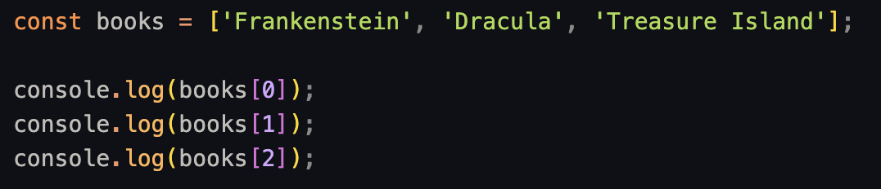
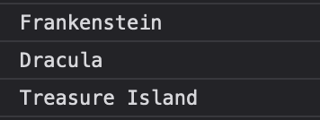
Accessing array elements

Slide 7
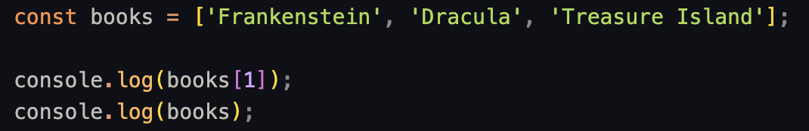

Accessing values
Accessing values this way will not modify the array.
This will be important later.

Slide 8

Updating values
What if we want to change a value in the array?
We can use bracket notation to do so:

Slide 9
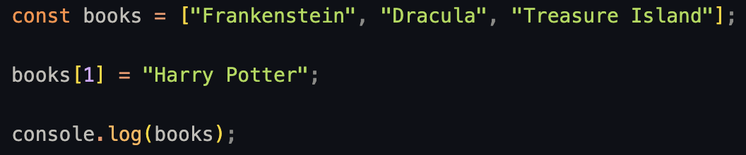
Updating values
For example:

Slide 10
Exercise 1: Accessing Elements
Given the following array of books:
const books = ["Frankenstein", "Lord of the Rings", "The Hobbit"];
Log the first book to the console.
Log the last book to the console.
Log the second book to the console.

Slide 11
Exercise 2: Updating Values const books = ["Frankenstein", "Lord of the Rings", "The Hobbit"];
Using the same books array:
Change "Frankenstein" to "Percy Jackson".
Log the updated array to the console.

